Slide 1
RA 505 Robot Sensing and Vision Lecture 32
Dr. Rishikesh Kulkarni
Department of Electronics and Electrical Engineering
IIT Guwahati

Slide 2
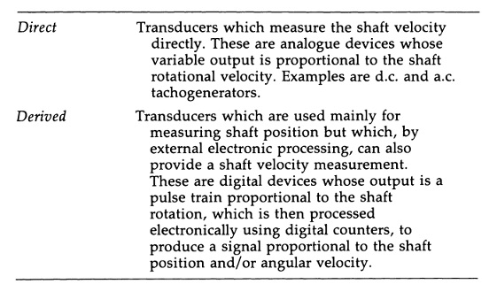
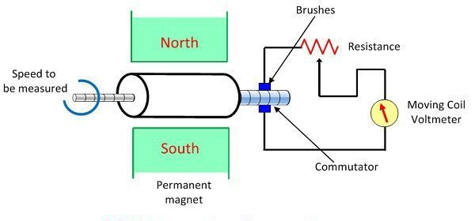
Velocity sensors
Optical, capacitive or magnetic
potentiometer as a velocity transducer
require interfacing to a differentiator circuit
difficult to stabilize
use is not recommended
Tachogenerator
Dual of electric motor
DC type (dynamo)
AC type (alternator)
Need no power supply
Analog output, requires ADC

Slide 3
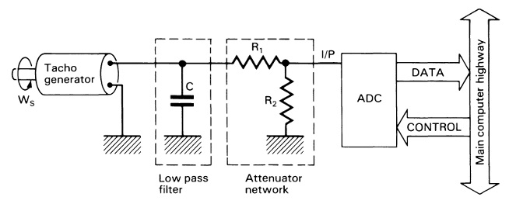
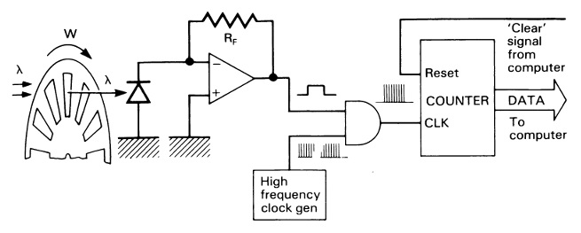
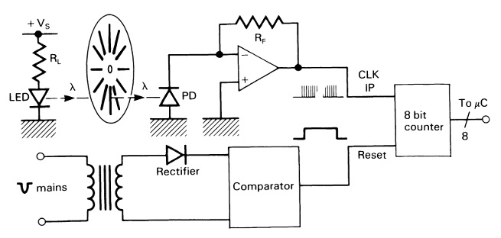
Interfacing of Velocity sensors
Tachogenerator
Optical Encoder
Low voltage pulse train
frequency is proportional to angular speed
Counting number of lined detected by photo-diode in unit time
Time taken by the photo-diode to detect a single line

Slide 4
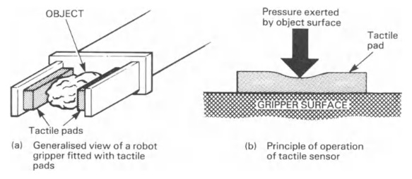
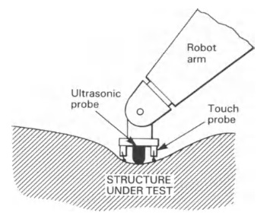
Tactile sensors
Tactile sensing allows continuous measurement of the pressure distribution across an array of so called ‘tactels’
detection of slippage
Inspection

Slide 5
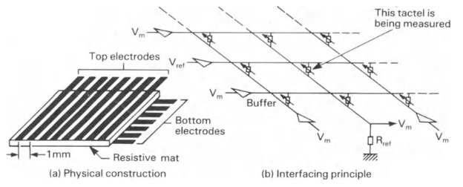
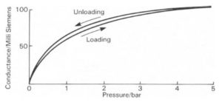
Resistive Tactile sensors
Most popular
higher sensitivity and x-y resolution
carbon fibres, conductive rubbers, media impregnated with conductive dopants (lower hysteresis and larger dynamic range)
Change in resistance in function of pressure
Capacitive effect

Slide 6
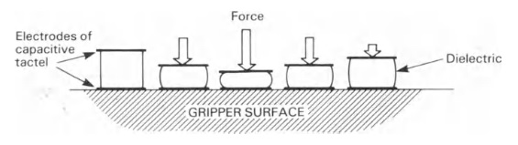
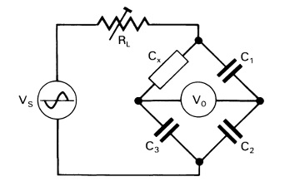
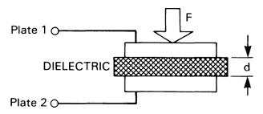
Capacitive Tactile Sensors
potential for measuring higher pressures
inherently less malleable
more mechanically robust
bigger tactel size
lower x-y tactel resolution

Slide 7
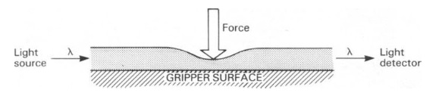
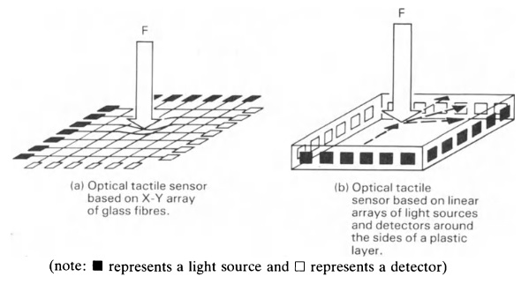
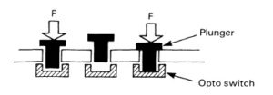
Optical Tactile Sensors
changing the light absorption characteristics of the transparent medium under the effect of an applied force
plastics and glass fibres
used within a robot multisensory feedback system

Slide 8
Resistance Strain Gauge
Highly popular passive type transducers
stress (force/unit area) and strain (elongation or compression/unit length) is developed on a object due to applied pressure
strain is used as an index of pressure
If a metal is compressed or stretched, its resistance changes on account of changes in its dimensions, i.e., length and cross-sectional area
Types
Wire strain gauges
Foil strain gauges
Semiconductor strain gauges

Slide 9
Resistance Strain Gauge
Wire strain gauges
unbounded resistance wire strain gauges
Bonded resistance wire strain gauges.
Fine wire: about 25 um or less
Carrier: thin sheet of paper.
the carrier mounting of wire structure and carrier adhesion on the object surface plays a crucial role in strain measurement accuracy

Slide 10
Resistance Strain Gauge
Resistance of a conductor
change in resistance due to the change in dimension and change is fundamental property of the material (piezoresistance)
Strain
Poisson ratio:

Slide 11
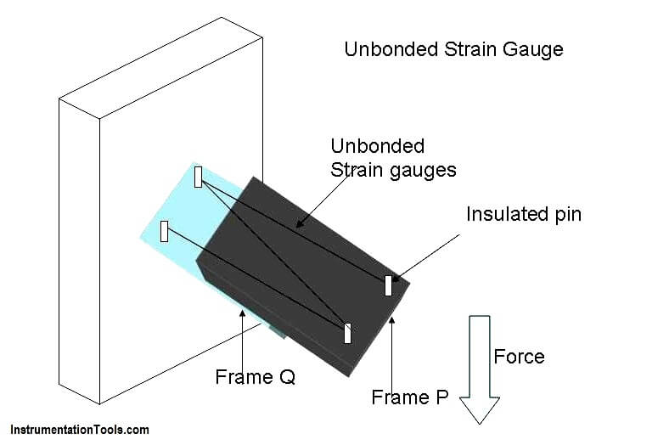
Resistance Strain Gauge
Unbounded metal-wire gage
Bonded metal-wire gage
Bonded metal-foil gage
Vacuum-deposited thin-metal-film gage
Sputter-deposited thin-metal-film gage
Bonded semiconductor gage
Diffused semiconductor gage

Slide 12
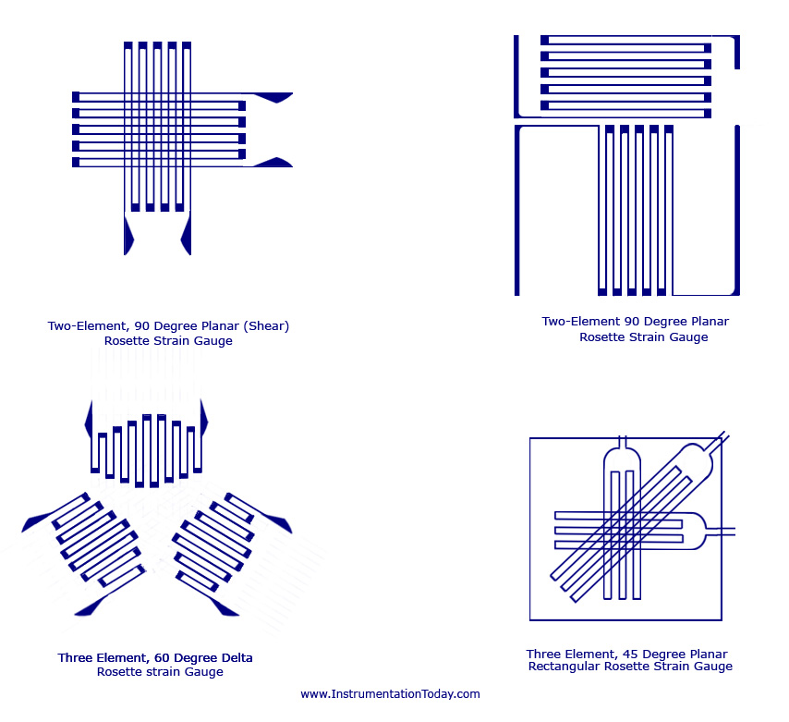
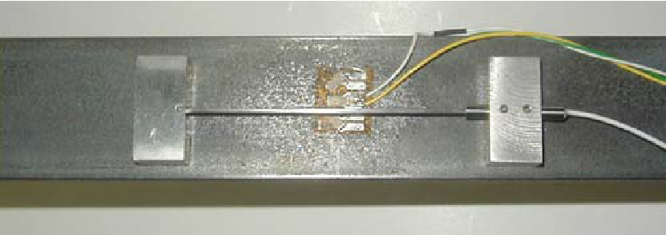
Resistance Strain Gauge
Bonded metal foil strain gauges
Copper-Nickel, Nickel-Iron alloys;
Thin metal grid mounted on flexible or brittle carrier;
measurement of average strain over an area;
Types of gauges are: Grid, Rossette, Torque and Helical.
The area is comparatively more than the wire strain
The resistive film thickness is typically 0.2mm thick.
120 Ω, 350 Ω, 1000 Ω

Slide 13
Resistance Strain Gauge
Rosette are nothing but three strain gauges overlapping at a same point manufactured on the same carrier material.
Rosettes are used for the measurement of force, velocity, pressure and displacement in applications such as aircraft and missile production, mechanical engineering, railroad, car manufacturing and other industries.

Slide 14
Resistance Strain Gauge

Slide 15
Resistance Strain Gauge

